Slide 1
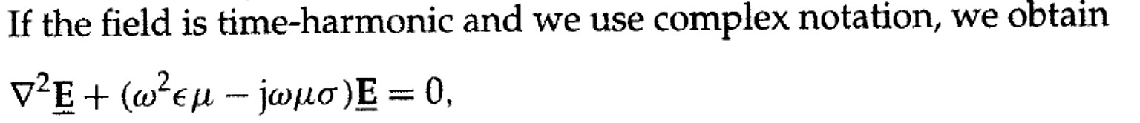

Antenna and Wave Propagation (Chapter eight)
Diyala University Engineering Collage
Communication Dep. 3rd Stage Asst. Lect. Jinan N. Shihab
The Wave Equation
In general, waves are means of transporting energy or information.
Typical examples of EM waves include Radio waves, TV signals, radar beams, and light rays. All forms of EM energy share three fundamental characteristics: they all travel at high velocity; in traveling, they assume the properties of waves; and they radiate outward from a source, without benefit of any discernible physical vehicles.
Or can be rewrite the equation above as:-
��𝑬− ��𝑬= �
𝒂𝒏�
��𝑯− ��𝑯= �
Where:-
γ = j ωμ (σ
+ j ωε )
2
= -ω ² με + j ωμσ
γ = α + jβ
γ = propagatio n constant
α= attenuation constant as a measure of the wave is attenuated while traveling in a medium.
β = phase constant.
Plane Wave
A plane wave is a wave whose phase is constant over a set of planes
Uniform Plane Wave
A uniform plane wave is a wave whose phase and magnitude are both constant. Our major goal is to solve Maxwell's equations and derive EM wave motion in the following media:-

Slide 2


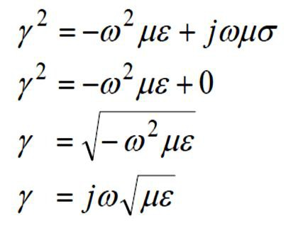
Antenna and Wave Propagation (Chapter eight)
Diyala University Engineering Collage
Communication Dep. 3rd Stage Asst. Lect. Jinan N. Shihab
1- The propagation in Free Space media (𝝈 = � ):-
Free space is nothing more than the perfect dielectric media:
α = 0 ,
β = ω μ ε = ω / c
0 0
u =
ω
β
=
1
= c , λ =
2π
β
ε
0 0
8
u = c ≈ 3 × 10 m / s
2- The propagation in lossless dielectric media (σ = 0)
But � = � + 𝒋�
then
� = � 𝒂𝒏� � = �√��
� �
�_{𝒑}= � = √�� ,
�
��
𝜼= √ = �𝟕�√ 𝛀
� �
�

Slide 3
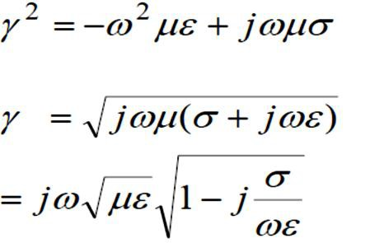
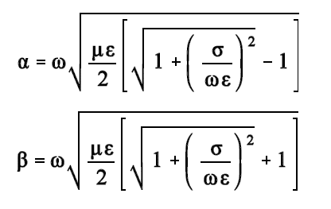
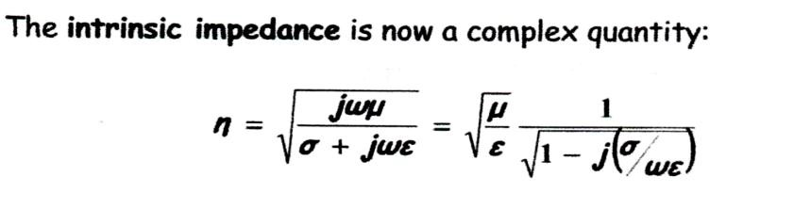
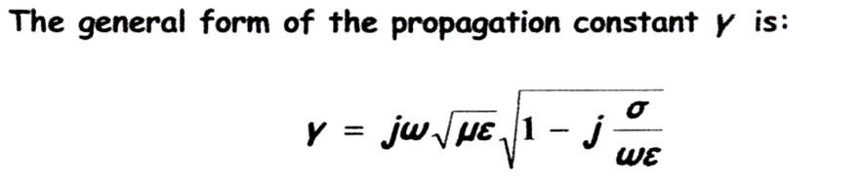
Antenna and Wave Propagation (Chapter eight)
Diyala University Engineering Collage
Communication Dep. 3rd Stage Asst. Lect. Jinan N. Shihab
3- Plane wave in lossy dielector (𝝈 ≠ � ):-
A lossy dielectric is a medium in which an EM wave loses power as it propagates due to poor conduction.
𝜎
Condition
𝑤�
≪ 1
𝑩�� � = � + 𝒋�
�
�_{𝒑}= �
��
𝑎𝑛�� = �
4- Plane wave in good conductor and skin depth (𝝈 = ∞ )
𝝈
Condition
��
≫ �

Slide 4
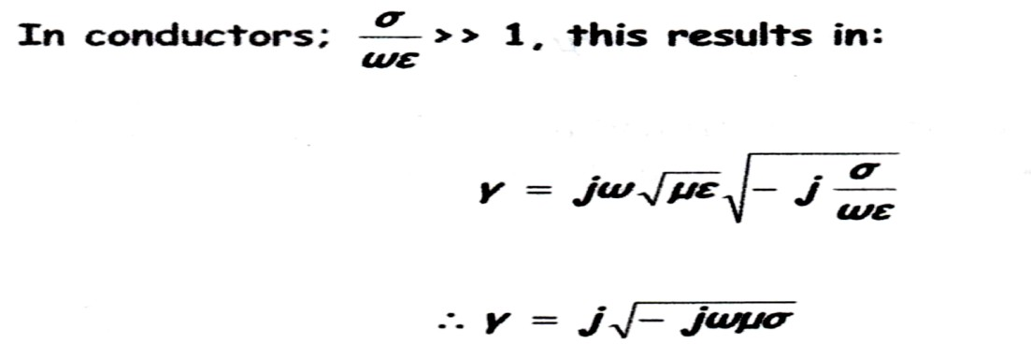
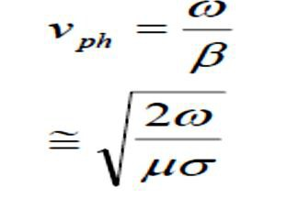
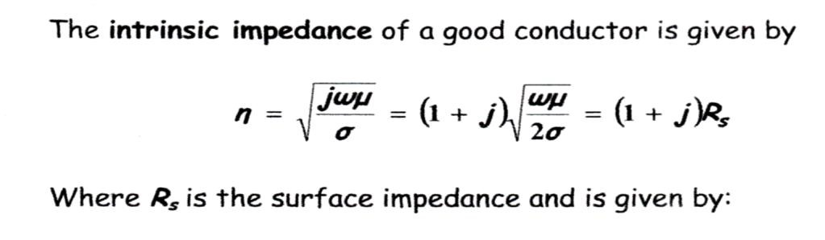

Antenna and Wave Propagation (Chapter eight)
Diyala University Engineering Collage
Communication Dep. 3rd Stage Asst. Lect. Jinan N. Shihab
� = � = √
��𝝈
�
The exponential factor �^{−��} of the traveling wave becomes �^{−�} =0.368 when � =
�
��𝝈
√ �
The inverse of the attenuation constant for good conductors is defined as the skin depth �� . The skin depth defines the distance over which a plane traveling in a good conductor wave decays by an amount of e⁻¹ = 0.368.
�
�
�
�� = =
√ �� 𝝈
�

